Slide 1
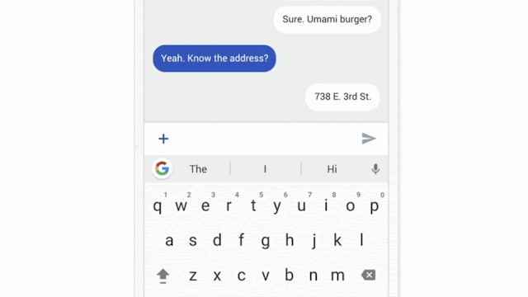
Federated Learning
姜育刚，马兴军，吴祖煊
https://ai.googleblog.com/2017/04/fed erated-learning-collaborative.html

Slide 2
Recap: week 10
口 Common Tampering and Deepfakes
口 Image Manipulation Detection
口 Video Manipulation Detection

Slide 3
This Week
口 Federated Learning
口 Privacy in Federated Learning
口 Robustness in Federated Learning
口 Challenges and Future Research

Slide 4
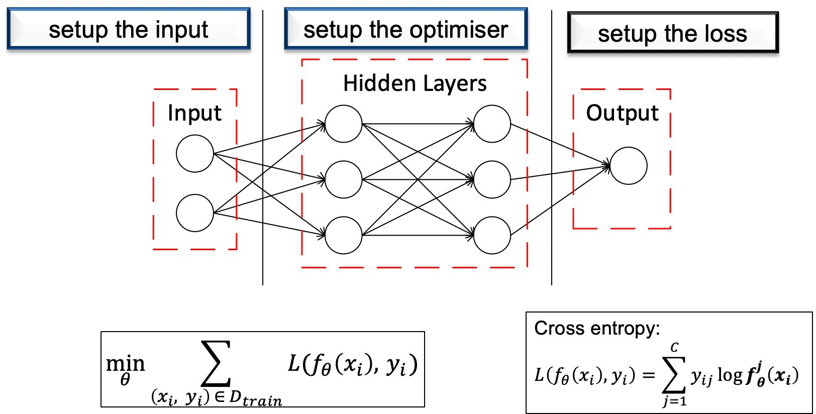

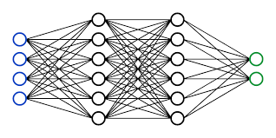
Traditional Machine Learning
Data
Model
Data and model in one single place

Slide 5


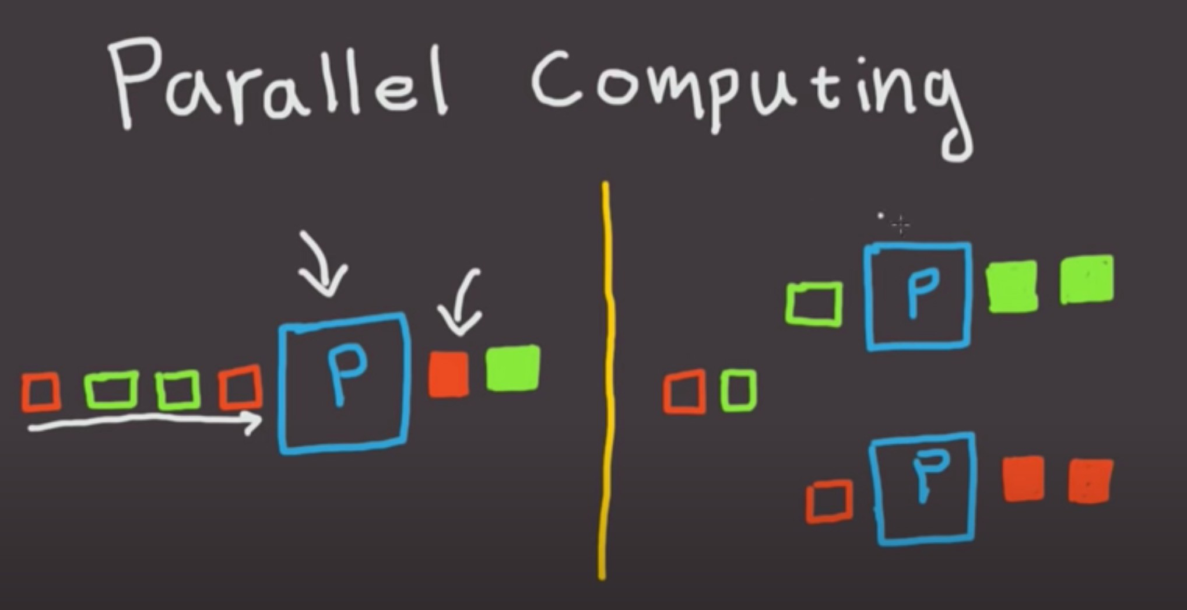




Traditional Machine Learning
What if we need more data?
Data
Model
Using multiple GPUs
Data Gathering

Slide 6
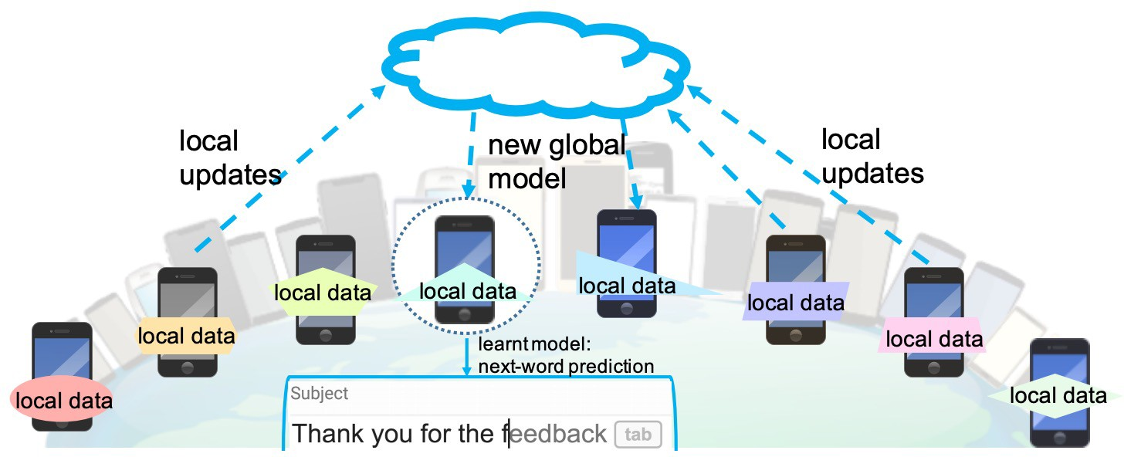
Federated Learning: What is it?
Next word prediction on mobile.
Google: Federated Learning: Collaborative Machine Learning without Centralized Training Data
Federated Learning: Challenges, Methods, and Future Directions, https://arxiv.org/pdf/1908.07873.pdf

Slide 7
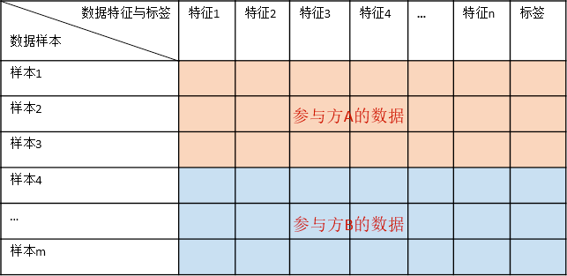
Federated Learning: Types
Horizontal FL（横着切）: same features, different samples
Federated Machine Learning: Concept and Applications, https://arxiv.org/pdf/1902.04885.pdf

Slide 8
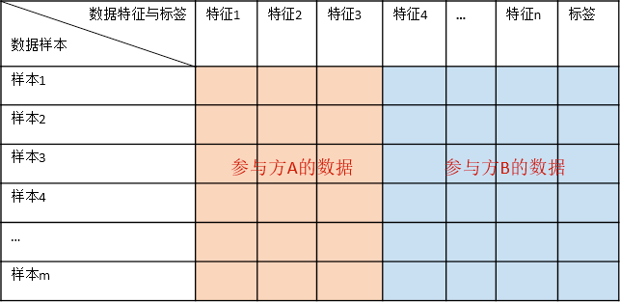
Federated Learning: Types
Vertical FL（纵着切）: same samples, different features
Federated Machine Learning: Concept and Applications, https://arxiv.org/pdf/1902.04885.pdf

Slide 9
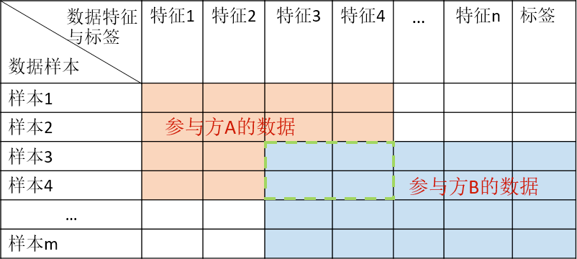
Federated Learning: Types
Federated Transfer Learning: different samples, different features
Federated Machine Learning: Concept and Applications, https://arxiv.org/pdf/1902.04885.pdf

Slide 10
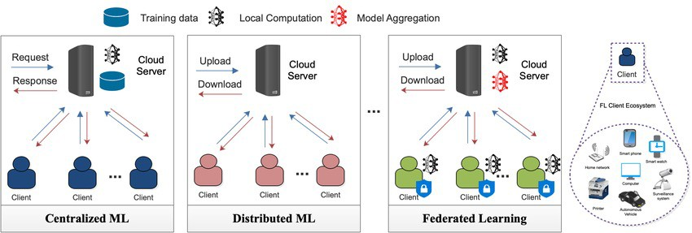
Compare Different Paradigms
Federated Machine Learning: Concept and Applications, https://arxiv.org/pdf/1902.04885.pdf

Slide 11
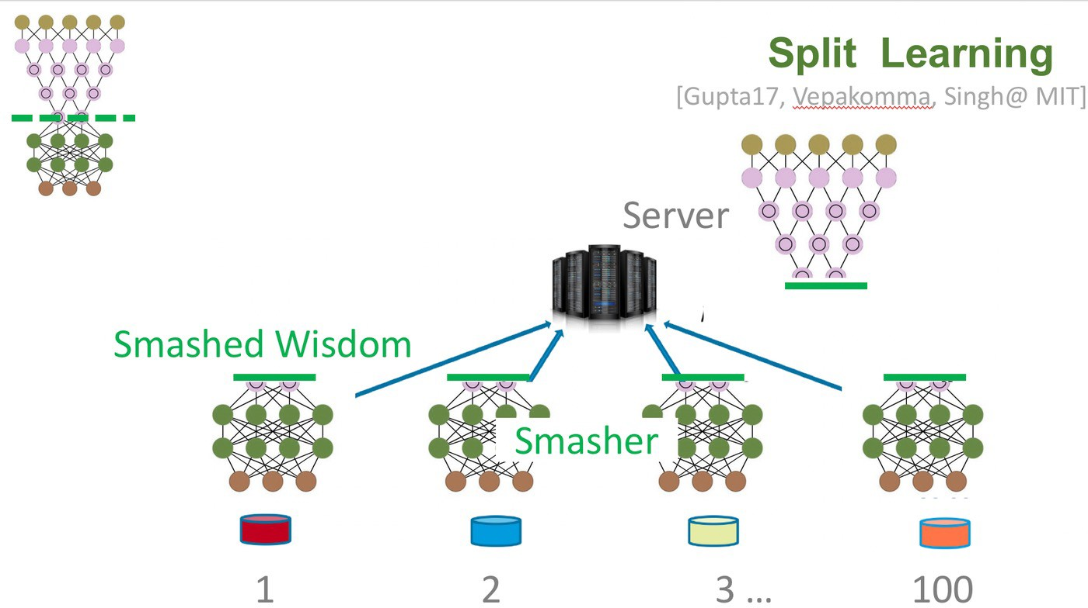
Compare Different Paradigms
Split Learning vs Federated Learning
https://www.media.mit.edu/projects/distributed-learning-and-collaborative-learning-1/overview/

Slide 12
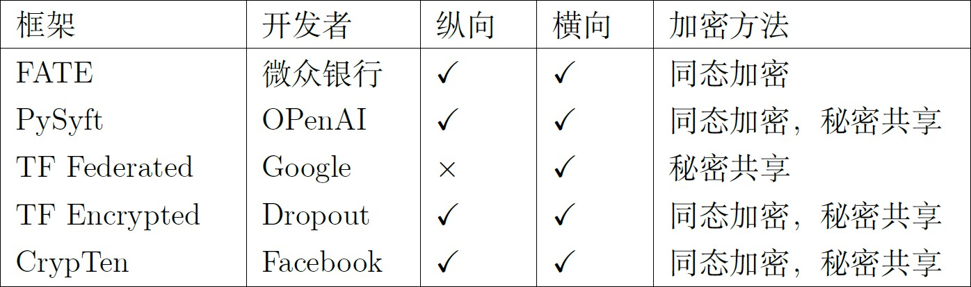
Federated Learning Frameworks
HE: homomorphic encryption SS: secret Sharing

Slide 13
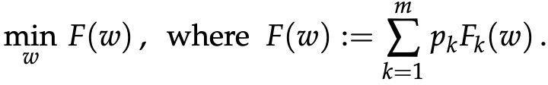
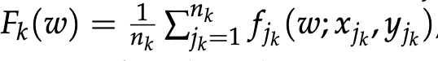
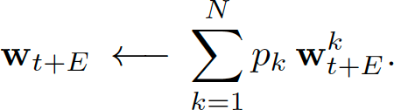
Objectives and Updates in FL
Global objective
Local objective:
Local Updates:
Global Aggregation (e.g. FedAvg):

Slide 14
Federated Learning – Major Challenges
Expensive Communication
Systems Heterogeneity
Statistical Heterogeneity
Privacy and Security Concerns
Federated Learning: Challenges, Methods, and Future Directions, https://arxiv.org/pdf/1908.07873.pdf

Slide 15
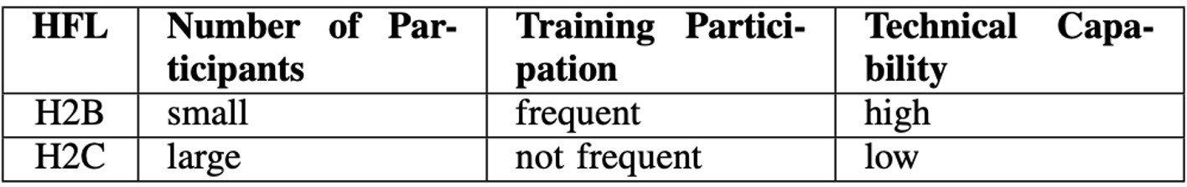
Federated Learning - Horizontal
HFL can further be divided into …?
Federated Learning: Challenges, Methods, and Future Directions, https://arxiv.org/pdf/1908.07873.pdf

Slide 16
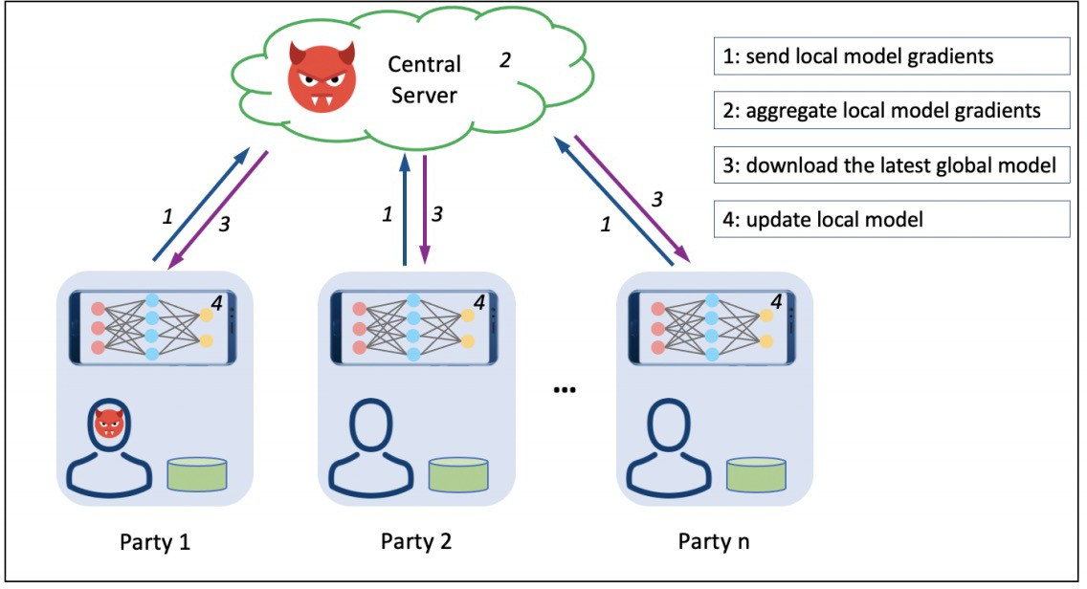
Privacy and Security Threats
Lyu et al. “Privacy and robustness in federated learning: Attacks and defenses.” TNNLS, 2022.

Slide 17
Summary of Threat Models
□ Insider vs Outsider □ Insider Attacks
FL server (insider)
FL participants (insider)
Eavesdroppers (outsider)
Service users (outsider)
Byzantine: the worst attacker, knows everything about the system, does not obey the protocol, send arbitrary updates, even collude with each other.
Sybil: taking over the network by simulating many dummy participants, out-vote the honest users
Semi-honest vs Malicious
Semi-honest setting
Malicious setting
Training-time vs Test-time
Steal private data, steal model, corrupt the model (training time)
Adversarial attack (test time)

Slide 18
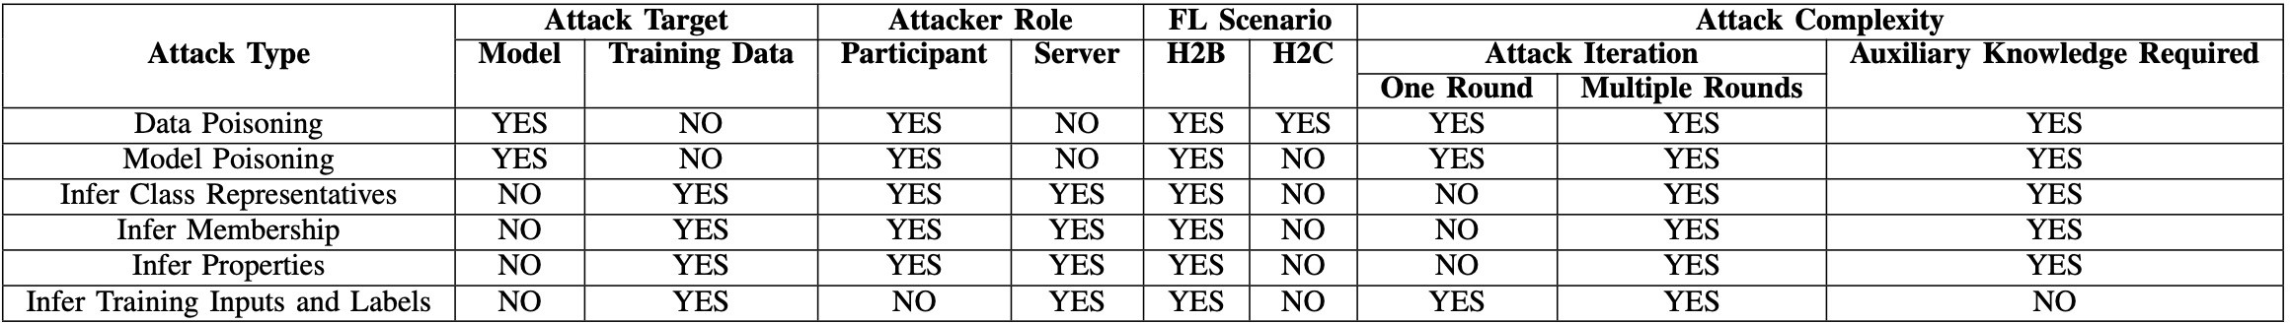
Summary of Attacks
Existing attacks against server-based FL

Slide 19
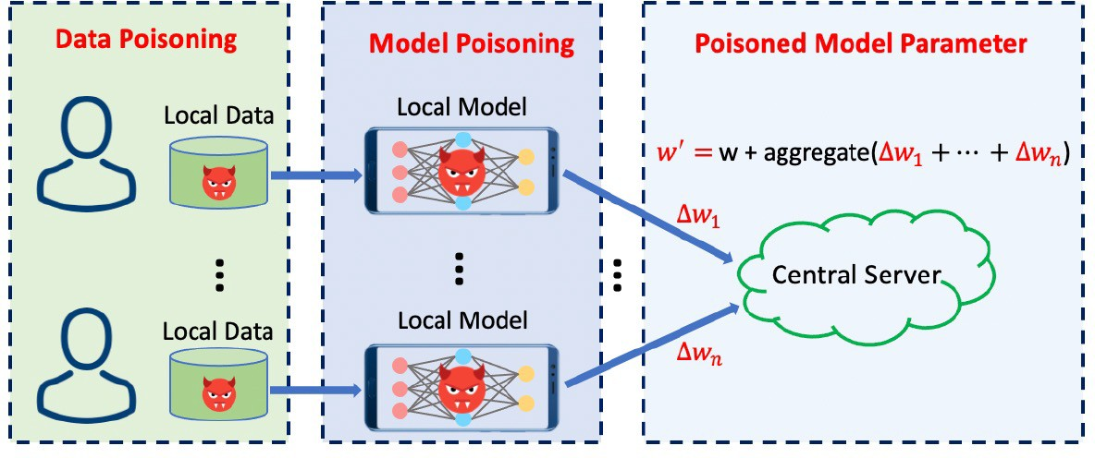
Poisoning Attacks
Data poisoning vs model (weight) poisoning

Slide 20
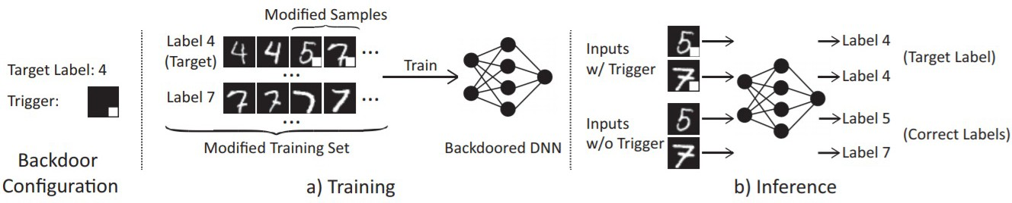
Data Poisoning Attacks in Traditional ML
□ Dirty-label Poisoning
Label flipping (only change labels)
Dirty-label backdoor (change
inputs and labels)
Clean-label Poisoning
Clean-label backdoor (only change inputs)

Slide 21
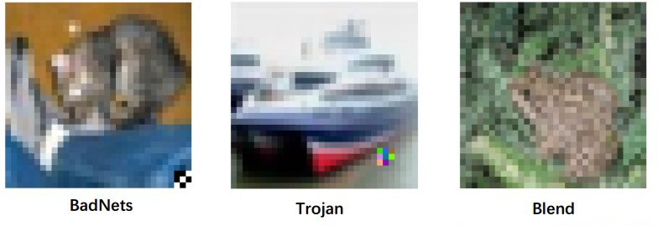
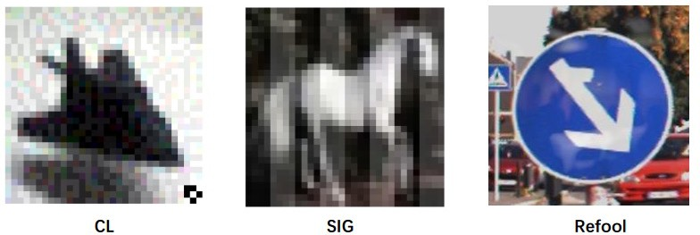
Data Poisoning Attacks in Traditional ML
A simple pattern can make the model to memorize

Slide 22
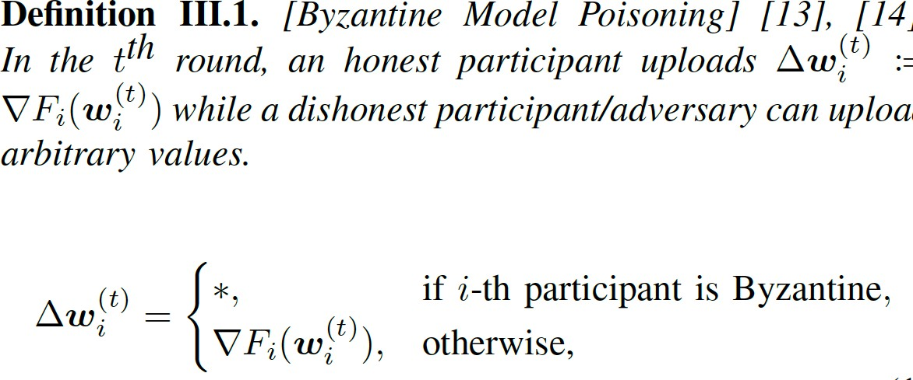
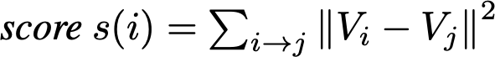
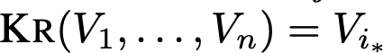
FL Poisoning Attacks – Model Poisoning
Main characteristics:
Change local model weights
Mostly Byzantine attack (attacker can do anything to the weights)
Can attack Byzantine-robust aggregation mechanisms such as Krum and coordinate- wise median instead of weighted averaging
Krum:

Slide 23
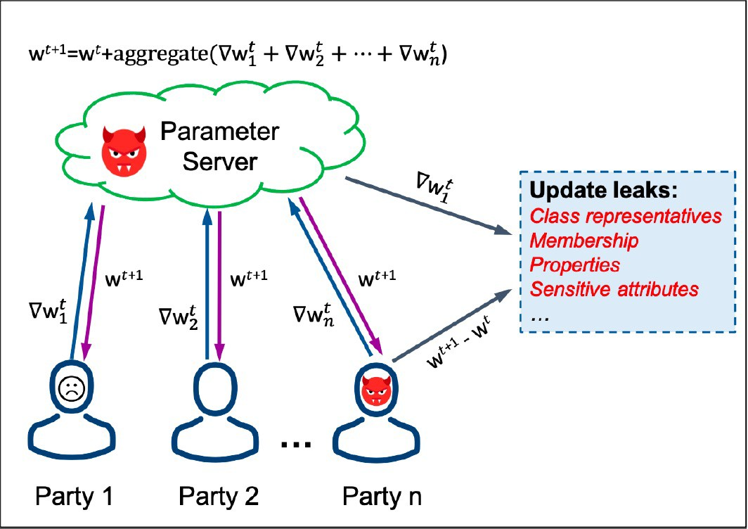
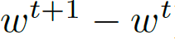
Privacy Attacks
For every communication round, local clients have the chance to reverse engineer others’ gradients.
From the reversed gradients, reverse engineer:
Representations
Membership
Properties
Sensitive attributes
In VFL: features

Slide 24
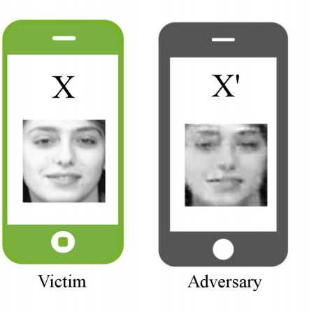
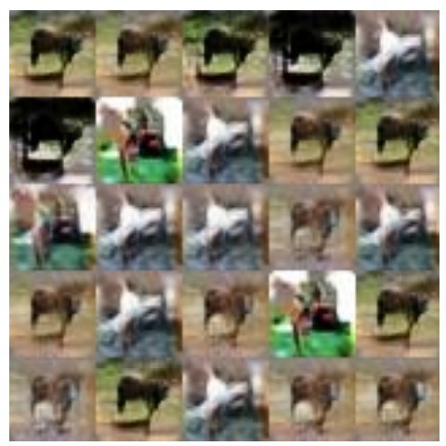
Privacy Attacks – Inference Attacks
Inference class representations using GANs
Reconstruct Alice’s face image
CIFAR-10 horse class
Deep models under the GAN: information leakage from collaborative deep learning, CCS 2017

Slide 25
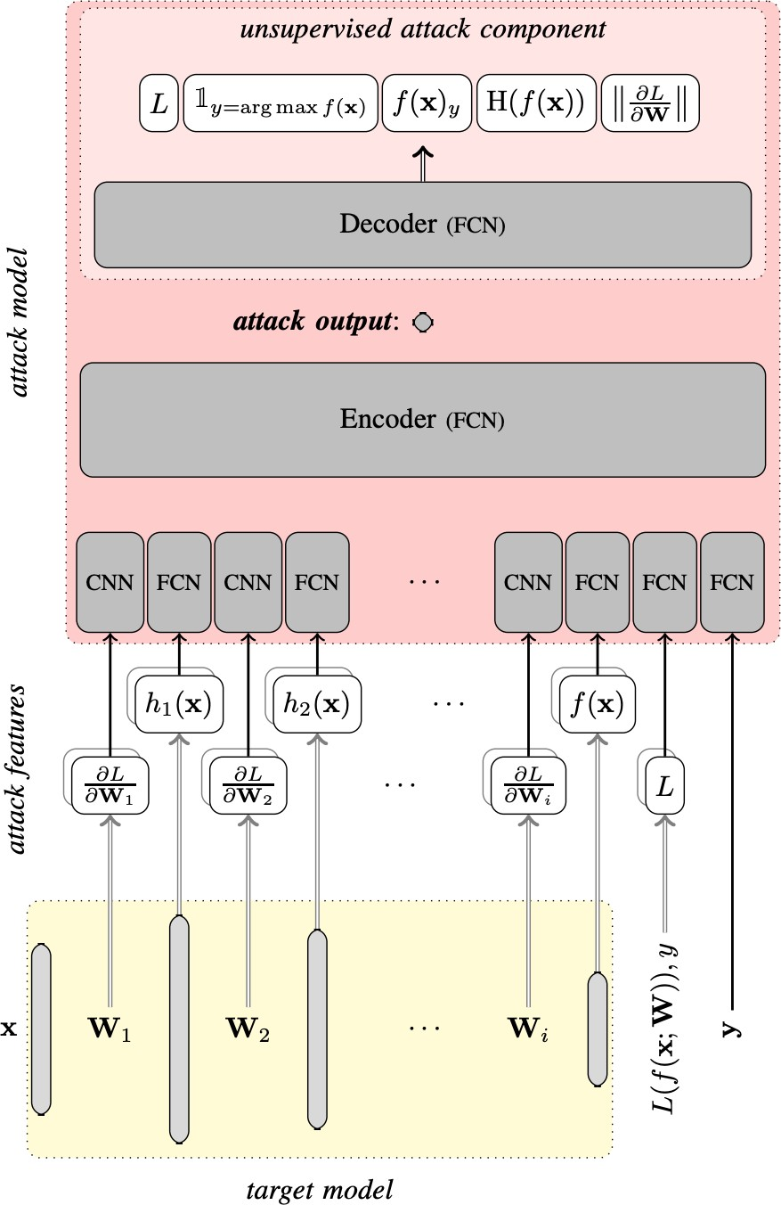
Privacy Attacks – Inference Attacks
Inference membership:
Passive attacks: observe and inference.
Active attacks: influence the target model in order to extract more information.
Weakness of FL: FL creates an environment for (almost) white- box attacks
Comprehensive privacy analysis of deep learning: Passive and active white-box inference attacks against centralized and federated learning, S&P, 2019

Slide 26
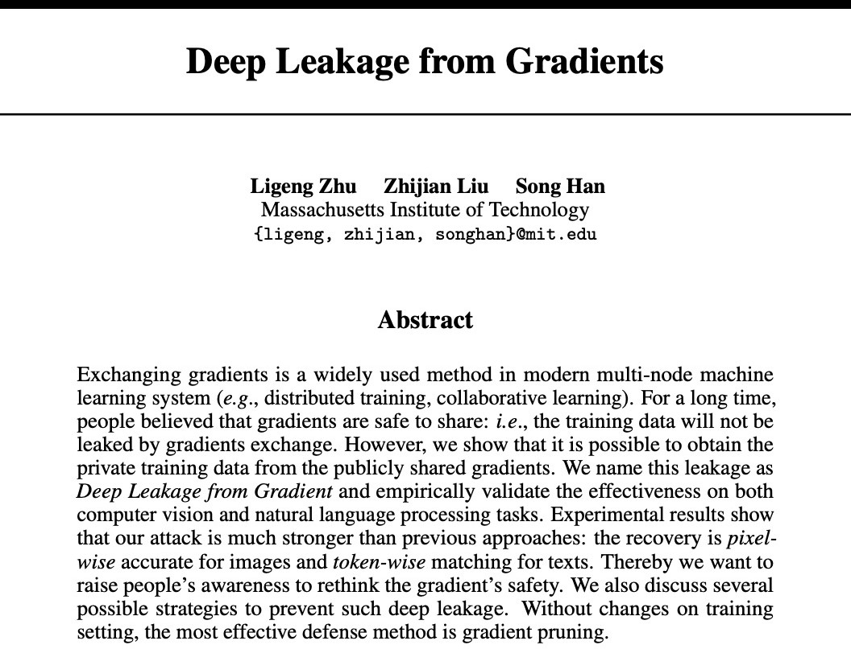
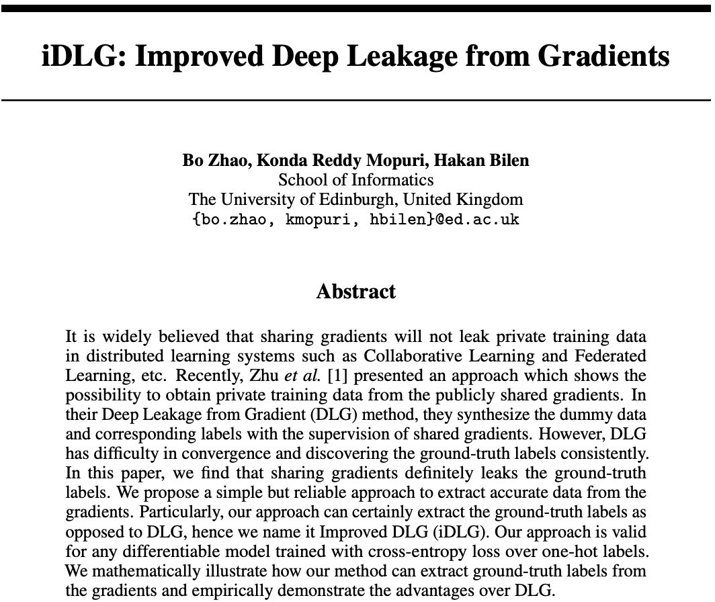
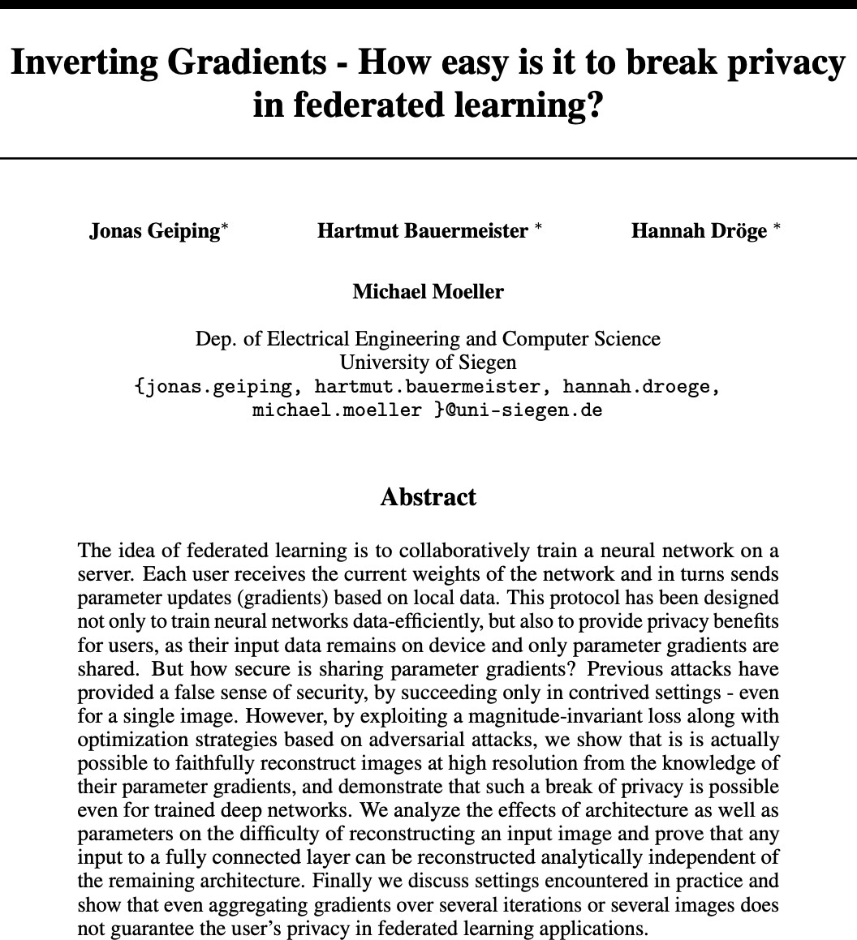
Privacy Attacks – Inference Attacks
Other inference attacks:
inferring properties, training data, labels ...
Deep Leakage from Gradient (DLG)
Improved Deep Leakage from Gradient (iDLG)
…

Slide 27
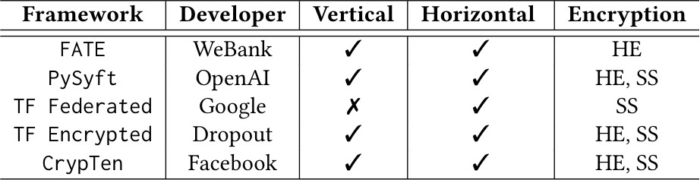
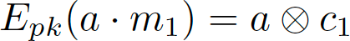
Defenses – Privacy Defense
Homomorphic Encryption:
RSA
El Gamal
Paillier
…
Homomorphic properties:
Allows computation directly on encrypted data (“可算不可见”)
Needs to be designed for each algorithm
A side note: attacking encrypted FL is challenging but still possible!

Slide 28
Defenses – Privacy Defense
2. Secure Multiparty Computation (SMC, Yao sharing):
SecureML (data-independent offline phase + fast online phase)
Offline multiplication triplets, truncate, sharing
Characteristics:
High level privacy
High computation and communication cost
Yao's Millionaires' problem
Protocols for Secure Computations, Andrew Chi-Chih Yao, 1982, UC Berkeley

Slide 29
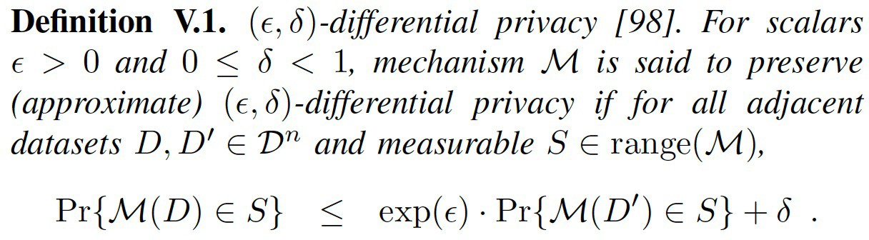
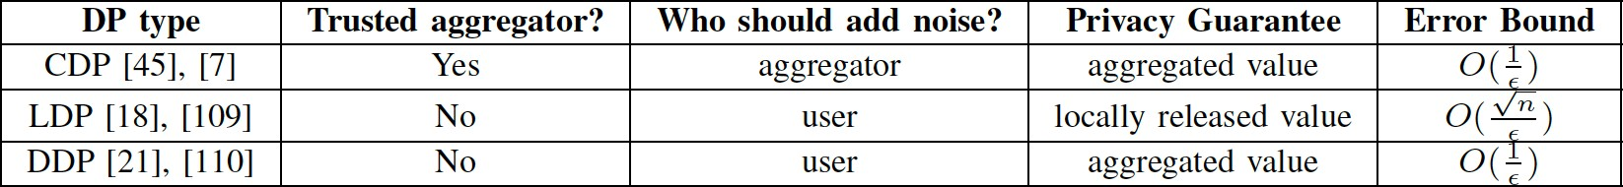
Defenses – Privacy Defense
2. Differential Privacy (DP):
Types of DP:
Local DP
Centralized DP
Distributed DP

Slide 30
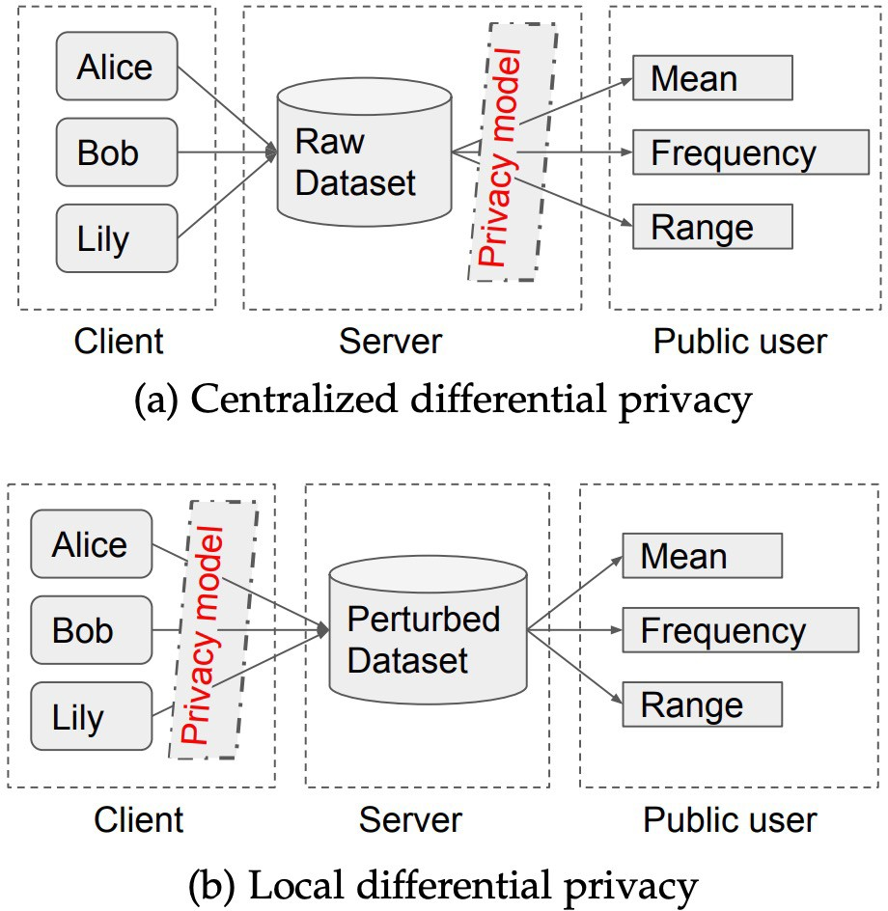
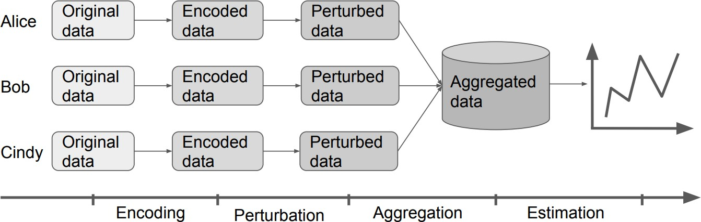
Defenses – Privacy Defense
2. Differential Privacy (DP):
Data flow of statistics under LDP

Slide 31
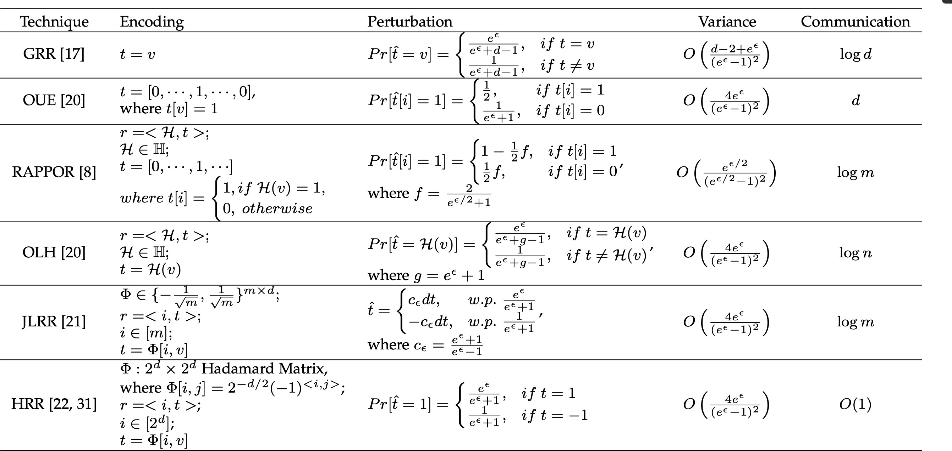
Defenses – Privacy Defense
2. Differential Privacy (DP):
Types of frequency estimation

Slide 32
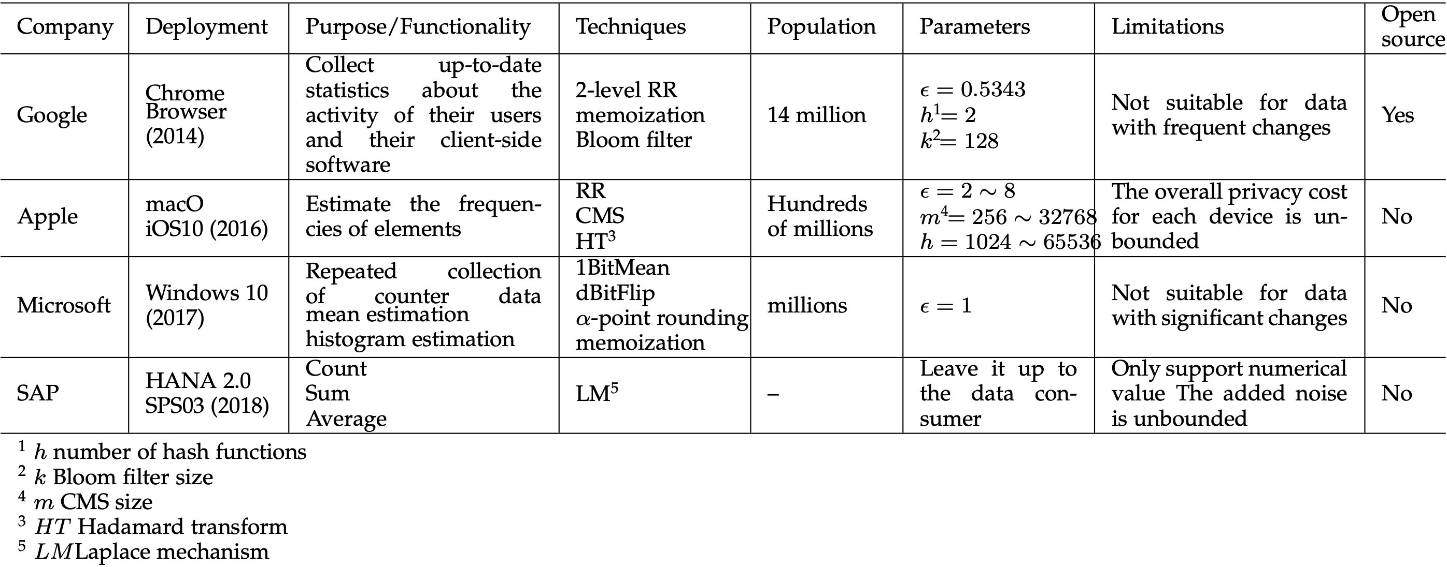
Defenses – Privacy Defense
2. Differential Privacy (DP):
Real-world applications.

Slide 33
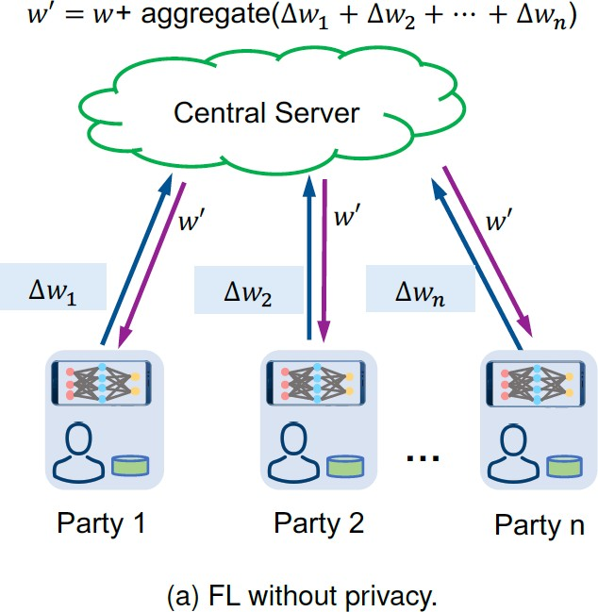
Vanilla FL

Slide 34
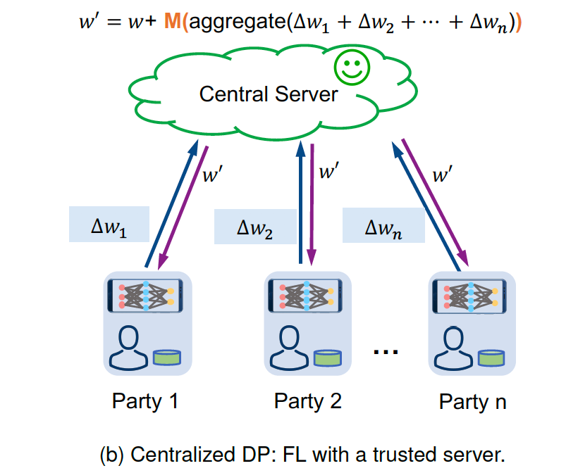
Centralized DP
M: A DP mechanism

Slide 35
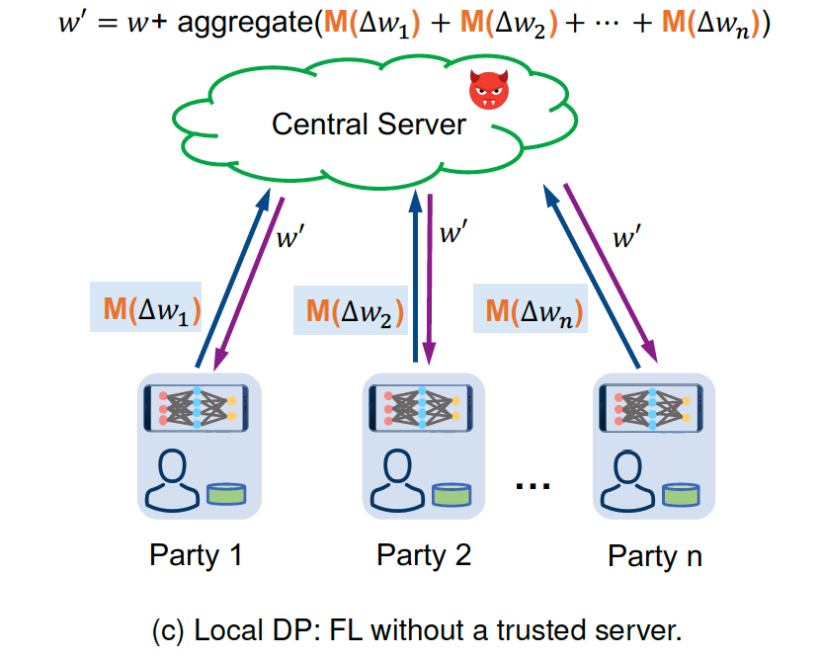
Local DP
M: A DP mechanism

Slide 36
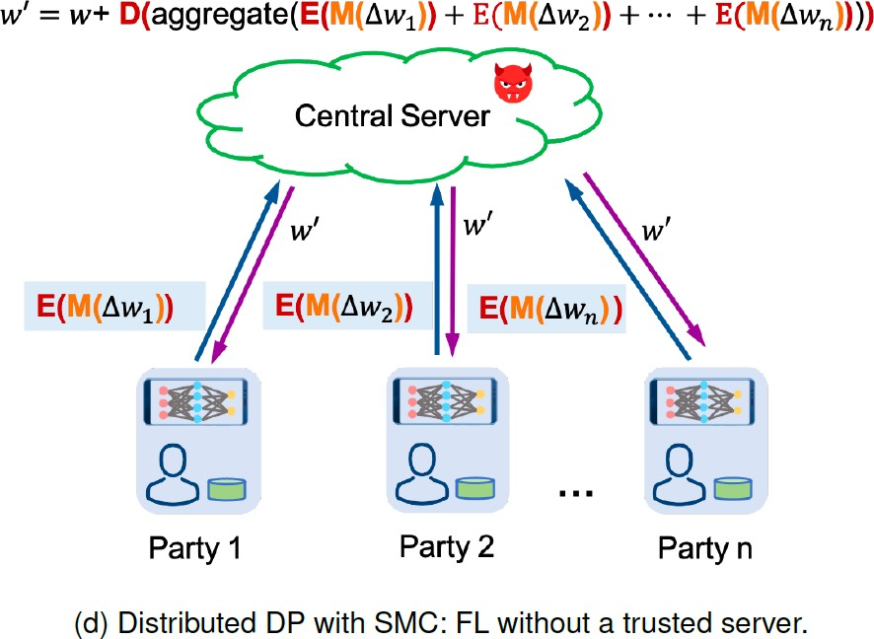
Distributed DP
M: A DP mechanism
E: encryption
D: decryption

Slide 37
Defenses – Byzantine Defense
Algorithm: Krum (for Byzantine robustness)
Setting: n participants, f are Byzantine, with 𝒏 ≥ 𝟐𝒇 + 𝟑
At communication round t,
server receives {𝜹^{𝒕} , 𝜹^{𝒕} , … , 𝜹^{𝒕} }
𝟏 𝟐 𝒏
for each 𝜹^{𝒕}:
𝒊
select the closest (L2 distance) n-f-2 into set 𝑪_{𝒊}
compute 𝒔𝒄𝒐𝒓𝒆 𝜹^{𝒕}
= ∑
𝜹^{𝒕} − 𝜹
𝒊 𝜹∈𝑪_{𝒊} 𝒊
𝜹_{𝒌𝒓𝒖𝒎} = 𝜹∗ = arg min{𝒔𝒄𝒐𝒓𝒆 𝜹^{𝒕} , …, 𝒔𝒄𝒐𝒓𝒆 𝜹^{𝒕}
}
𝟏 𝒏
𝜹
update global parameter: 𝒘^{𝒕.𝟏} = 𝒘^{𝒕} + 𝜹_{𝒌𝒓𝒖𝒎}
Blanchard et al. “Machine learning with adversaries: Byzantine tolerant gradient descent.” NeurIPS, 2017.

Slide 38
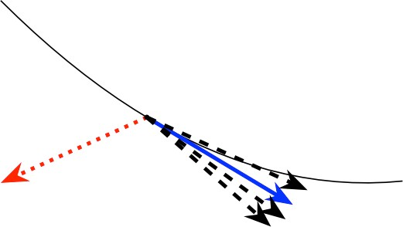
Defenses – Byzantine Defense
Algorithm: Krum (for Byzantine robustness)
红色：攻击梯度蓝色：真实梯度黑色：本地梯度
黑色曲线：损失函数
Blanchard et al. “Machine learning with adversaries: Byzantine tolerant gradient descent.” NeurIPS, 2017.

Slide 39
Defenses – Byzantine Defense
More robust aggregation methods:
Multi-Krum = Krum + Averaging
= Krum robustness + increased convergence speed
coordinate-wise median, coordinate-wise trimmed mean median is not good for convergence
Bulyan = Krum + trimmed median
Median and geometric-median
(Robust Federated Aggregation) RFA: approximate geometric median (not robust to Byzantine attacks)

Slide 40
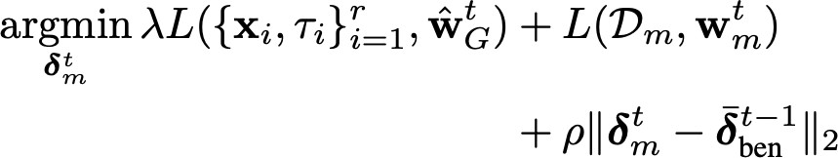
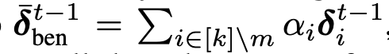
Defenses – Byzantine Defense
Model poisoning attack can break Krum and coordinate-wise median
𝜏/: adversarial target class
r: number of poisoned samples
𝐷₀: clean data
Reversed gradients from the last round.
𝑤^{?2} : estimation of the global parameters
1
Analyzing federated learning through an adversarial lens, ICML 2019.

Slide 41
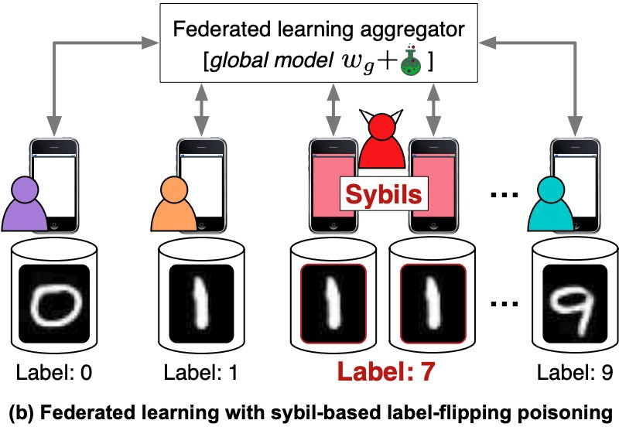
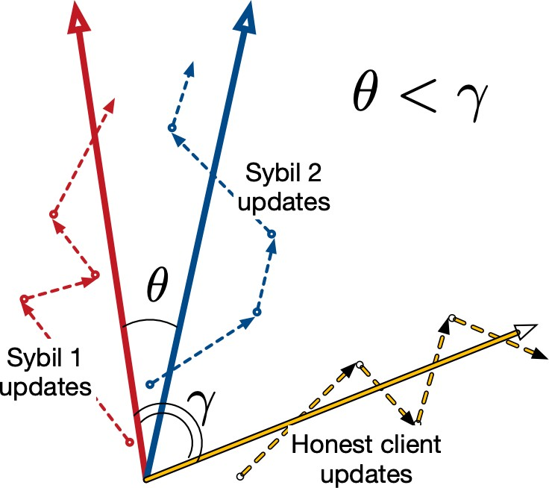
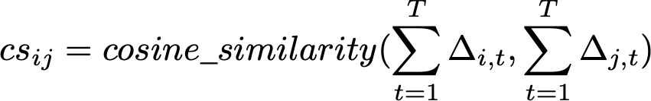
Defenses – Sybil Defense
From traditional ML: Reject on Negative Influence (RONI)
With a clean validation dataset
It requires uniform distribution in non-IID setting, not good.
FoolsGold:
Sybil share the same objective, drifts away from the original objective Core idea: cosine similarity
FoolsGold: Mitigating Sybils in Federated Learning Poisoning, https://arxiv.org/abs/1808.04866

Slide 42

Defenses – Sybil Defense
Distributed backdoor attack (DBA) can bypass both RFA and FoolsGold.
DBA: Distributed Backdoor Attacks against Federated Learning, ICLR 2020.

Slide 43

Defenses - Summary
Defense against Federated Learning Poisoning. n: number of participants.

Slide 44
Remaining Challenges and Future Research
□ Curse of dimensionality
Larger models are more vulnerable
Sharing weights/gradients may not be a good idea
□ Weaknesses of current attacks
GAN attack assumes the class of data is from one single participant
DLG/iDLG work with second-order gradient method (expensive) and small minibatch-gradients (B=8)
□ Vulnerability to free riders: pretend to have data but not.

Slide 45
Remaining Challenges and Future Research
□ Weakness of Current Privacy-preserving Techniques
Secure aggregation is more vulnerable to poisoning attacks since individual updates cannot be checked
Adversarial training (IID or non-IID, local or global, training or distillation)?
Sample-level DP does not stop attribute/property/statistical inference attacks
DP hurts accuracy, efficiency (is millions of participant-level DP possible?)

Slide 46
Remaining Challenges and Future Research
Defense efficiency
Expensive to check each participant (detection)
When and how to deploy a defense?
Hard to achieve all objective of private and secure
Efficiency
Privacy
Robustness
Generalization
Collaborative fairness

Slide 47

Remaining Challenges and Future Research
FL: optimization and convergence
GD -> SGD -> Parallel SGD -> Local SGD
Federated Accelerated Stochastic Gradient Descent Tighter Theory for Local SGD on Identical and Heterogeneous Data, AISTAS, 2020; On the convergence of FedAvg on non-IID data, ICLR 2020

Slide 48
谢谢！

